Slide 1
SQL Lesson 19a
Data Definition Language - Views
V1.0 2020

Slide 2
Lesson Objectives
After completing this lesson you will be able to
Create views
Retrieve data using views
Modify views

Slide 3
Views
Introduction
Create views
Modify views
Drop views

Slide 4
Views
Object | Description
Table | Basic storage unit composed of rows and columns
View | Shows subsets of data from one or more underlying tables

Slide 5
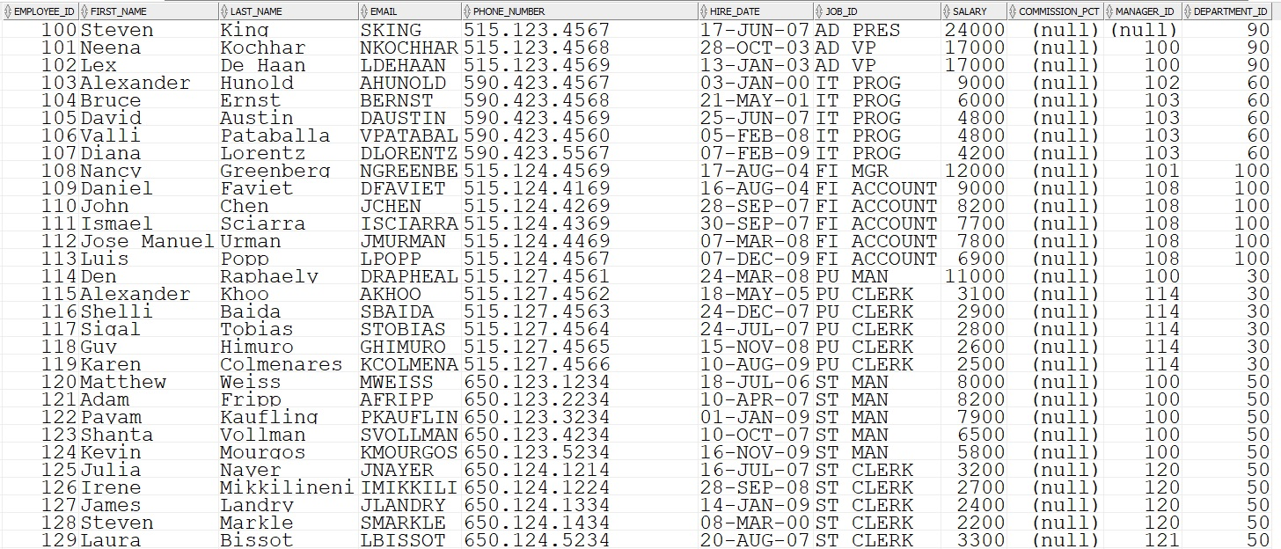
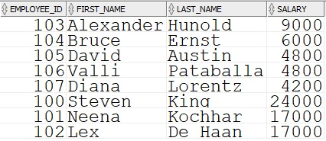
Views
What is a view?
Views control which columns and/or rows a user can see
Views present a subset of table data to a user
A view is a SELECT statement that has a name
Views are permanently stored in the Data Dictionary

Slide 6

Views
Advantages of views
Views allow users to see only the data they need to see
Views can make complex queries simple
Views present different versions of the same data to different users
Views are dynamic because they always show the current data in the underlying tables

Slide 7
Views
Introduction
Create views
Modify views
Drop views

Slide 8
Views
Creating a view
The CREATE VIEW statement is written with a subquery
CREATE OR REPLACE VIEW view_name
AS SELECT col1, col2, col3,etc
FROM tables
WHERE etc;

Slide 9
Views
Creating a view
A user may have no need to see data about employees outside of their own department
CREATE OR REPLACE VIEW emps50_vu
AS SELECT *
FROM employees
WHERE department_id = 50;
Describe the structure of the view
DESC emps50_vu

Slide 10
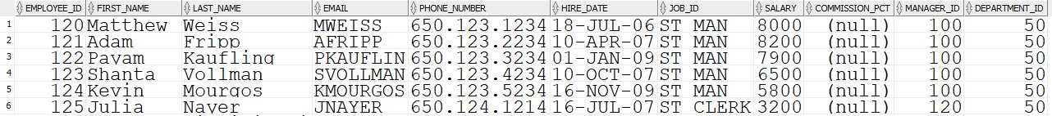
Views
Retrieving data using a view
SELECT *
FROM emps50_vu;
…

Slide 11
Views
Creating a view
All columns selected in a view must have a name
CREATE OR REPLACE VIEW yearly_pay_vu
AS SELECT employee_id, last_name, salary * 12 AS yearly_pay
FROM employees;

Slide 12
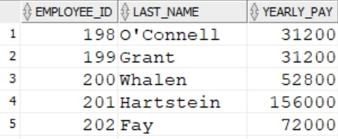
Views
Retrieving data using a view
SELECT *
FROM yearly_pay_vu;
…

Slide 13
Views
Introduction
Create views
Modify views
Drop views

Slide 14
Views
Modifying a view
Modify the emps50_vu by reducing the columns selected and giving each column an alias.
CREATE OR REPLACE VIEW emps50_vu (empid, fname, lname, sal, mgr, deptid)
AS SELECT employee_id, first_name, last_name, salary, manager_id, department_id
FROM employees
WHERE department_id = 50;

Slide 15
Views
Introduction
Create views
Modify views
Drop views

Slide 16
Views
Dropping a view
A view can be removed from the database without loss of data because it holds no data of its own
DROP VIEW view_name;
DROP VIEW yearly_pay_vu;

Slide 17
Quiz
True or false?
Views must be updated periodically to synchronize with their underlying tables
A view is a query with a name, permanently stored in the database

Slide 18
Review
In this lesson you learned how to
Create views
Retrieve data using views
Modify views

Slide 19
Questions?

